Slide 1
BLACK FRIDAY SALES USING MACHINE LEARNING
AKHILA GOTTEMUKKULA-700745898
HARI BABU GUTHI-700746155

Slide 2
ROLES AND RESPONSIBILITIES
Problem description and dataset information- Done by Akhila Gottemukkula_7007745898.
Model training with Random Forest with the features extracted in the above step- Done by Hari Babu- 700746155
Model training with XGBoost learning algorithm with the features extracted in the 1st step- Done by Akhila- 700745898
Creating model and parameters according to the training data set and also fitting the data to the models- Akhila-700745898
Report- Hari Babu-700746155

Slide 3
Motivation And Objectives
In every field customers are crucial.
A persons purchase history plays a crucial role in the evaluation of the persons purchase history. The purchase habits based must be evaluated based on the age, gender, occupation, and city categories
Last and final city categories because income spent on purchasing mainly depends on the locality they live on. The one who lives in the city spends much extra on shopping rather than the one lives in the rural area.
First we must understand the data in detail and figuring out the features required. Through utilizing such forecasting analytics, individuals should be capable of anticipating where customer evaluates the firm's development and aids with our comprehension of both the purchasing habits of such customers' businesses that offer improved transportation reliability assists in boosting revenue. This helps the customers in choosing the sustainable products based. The technical motivation is using machine learning algorithms which helps in higher accuracy rate.

Slide 4
Related Work
C. M. Wu et al. [1] has suggested a forecasting framework to investigate consumer's buying history but also forecast consumer spending mostly in upcoming. Black Friday Sales Dataset from analytics Vidhya is indeed the information that was mentioned. They include machine learning models like Linear Regression, MLK classifier, Decision Tree, Decision Tree with bagging, and Deep Learning method utilizing Keras. These algorithms were assessed using the measuring performance metric Root Mean Squared Error (RMSE).
Odegua, rising [2] have suggested a model for predicting purchases. This system employs K-Nearest Neighbor, Random Forest, and Gradient Boosting as the machine learning techniques.
Purvika Bajaj et al. [3] utilizing information gathered out of a supermarket, did sales figures. Linear Regression, K-Nearest Neighbors, and Random Forest are the algorithms employed in experiments. Root Mean Squared Error (RMSE), Variance Score, Training, and Testing Accuracy are employed to determine how precise these results were.
M.Sahaya Vennila et al. [8] has digested, implemented, & evaluated machine learning methods that forecast revenue. This Black Friday Sales Dataset from Kaggle is indeed the information being used testing and evaluation. Initial preprocessing of the information.

Slide 5
Problem Statement
Large number of purchases made during deals, items frequently sell in a short period of time, leaving customers disappointed but also ruining your entire workday. At this point many customers' aspirations were salvaged either by innovative internet shopping. Major goal is to satisfy customers with quality and quantity of products.
In order to attract customers with deals, retailers must have a records of customers who buy frequently sold items and keep much stock. These issues can be solved by using some algorithms and choosing the best one is our task.

Slide 6
Proposed Solution
Decision Tree:
A supervised learning method called decision tree can be used to solve classification and regression problems.It is a tree structured classifier where internal nodes stand in for a data sets features, branches for decision making process and each leaf node for classification results.
Random Forest:
The Random Forest Algorithm's ability to deal with large datasets with both dependent variables, just like in regression, plus predictor variable, as seen in classifications, is among its most crucial qualities. In terms of categorization issues, this delivers superior outcomes. Fundamental distinction seen between random forest method and the decision tree algorithm is that neither arbitrarily selects its root nodes then groups those nodes. For produce the necessary forecast, the random forest uses the bagging approach.

Slide 7
XGBoost Regressor
Several of the strongest together some effective ways to apply its Gradient Boosted Trees algorithm to everyone supervised learning problems called XGBoost. The ML technique XGBoost is also quite successful, resulting in it being frequently utilized during contests & contests.
In comparison to certain other gradient boosting approaches, XGBoost is nearly ten times quicker and offers strong predictive ability.
Additionally, this contains a range of regularizations that lessen fitting problem & enhance efficiency. It really is focused on function optimization by utilizing suitable regularization techniques and improving algorithms

Slide 8
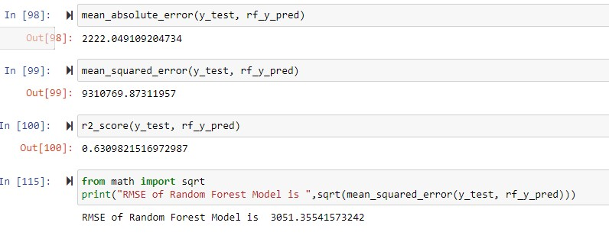
Results

Slide 9
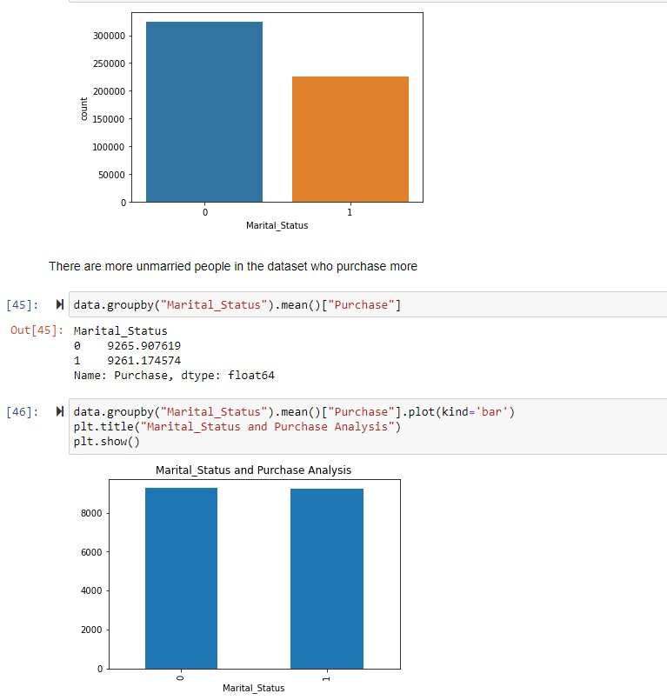
Results

Slide 10
References
[1] C. M. Wu, P. Patil and S. Gunaseelan, "Comparison of Different Machine Learning Algorithms for Multiple Regression on Black Friday Sales Data," 2018 IEEE 9th International Conference on Software Engineering and Service Science (ICSESS), 2018, pp. 16-20, doi: 10.1109/ICSESS.2018.8663760.
[2] Odegua, Rising. (2020). Applied Machine Learning for Supermarket Sales Prediction.
[3] Purvika Bajaj1, Renesa Ray2, Shivani Shedge3, Shravani Vidhate4, Prof. Dr. Nikhilkumar Shardoor5,”SALES PREDICTION USING MACHINE LEARNING ALGORITHMS'',International Research Journal of Engineering and Technology (IRJET) ,Vol 7 Issue 6,2020,eISSN: 2395-0056 p-ISSN: 2395-0072.
[4] Ramasubbareddy S., Srinivas T.A.S., Govinda K., Swetha E. (2021) Sales Analysis on Back Friday Using Machine Learning Techniques. In: Satapathy S., Bhateja V., Janakiramaiah B., Chen YW. (eds) Intelligent System Design. Advances in Intelligent Systems and Computing, vol 1171. Springer, Singapore.
[5]Potturi, Keerthan, "Black Friday A study of consumer behavior and sales predictions" (2021). Creative Components.

